Slide 1

Diabetes Prediction- PIMA INDIANS
By:
Unnaty Gandhi

Slide 2
About the data set:
Pima Indians Diabetes Database of National Institute of Diabetes and Digestive and Kidney Diseases
Donated by Vincent Sigillito
768 observations with 8 attribute values and an outcome variable
8 attribute values are independent variables and the outcome variable is binary in nature
All patients are females at least 21 years old of Pima Indian heritage

Slide 3

PREDICTORS

Slide 4

OBJECTIVE OF THE DATASET : To diagnostically predict whether or not a patient has diabetes
WHO raised an a concern that by 2030, diabetes will be 7th leading cause of death in the world.
It is a universal problem with overwhelming human, social, and economic impact, affecting around 300 million people worldwide.

Slide 5
Logistic Regression
Defines the relationship between predictors/independent variables (Pregnancies, Insulin Level, BMI, etc.) and the response/dependent variable (Outcome)
Dependent variable takes a binary form i.e. 0s and 1s (for ex. if a dependent variable predicts Diabetes then it takes the value 0 if a patient does not have diabetes, 1 otherwise.
Models the probability of an event occurring depending on the values of the independent variables which can be categorical/commercial
Classify observations by estimating the probability that an observation is in a particular category such as Diabetes or No Diabetes

Slide 6
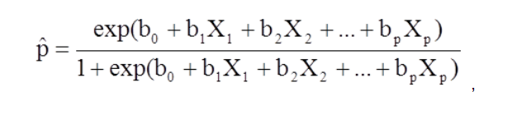
Logistic Regression Equation and Coefficient estimates
In Logistic Regression, coefficients are estimated using the Maximum Log Estimation (MLE) method

Slide 7
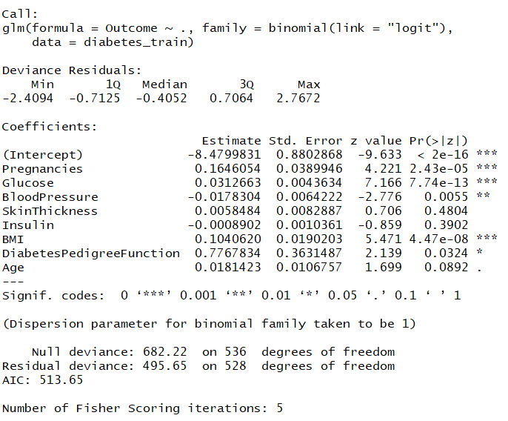
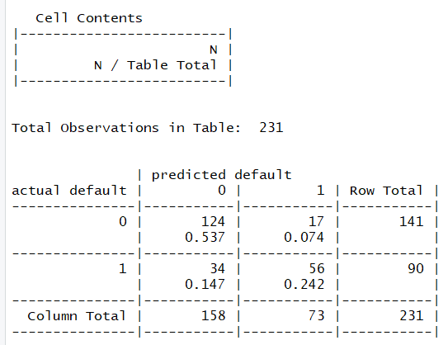
Logistic Regression Model on diabetes data set using glm()
Summary of Output
Confusion Matrix

Slide 8
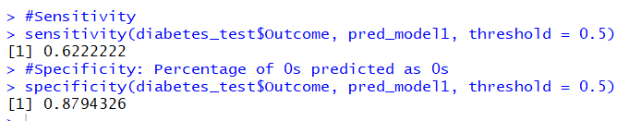
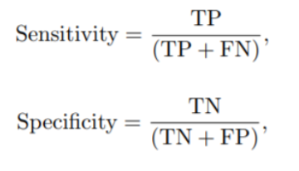
Performance Metrics: Sensitivity, Specificity, AUC and ROC
Sensitivity or True Positive Rate (TPR) is 0.6222, where TP = 56, FN = 34
Specificity or True Negative Rate is 0.8794, where TN = 124, FP = 17
False Positive Rate or FPR = 1-Specificity
= 1-(0.8794326)
= 0.121 approx.
ROC is a probability curve that shows a trade-off between sensitivity and False Positive Rate or 1-(Specificity)
FPR = TPR at 45-degree line
An ideal ROC curve is the one that is closer to the left border and away from 45-degree line (Sensitivity = 1, 1-specificity = 0)
AUC – Area Under the Curve represents degree or measure of separability
Higher AUC or closer to 1 is better at prediction

Slide 9
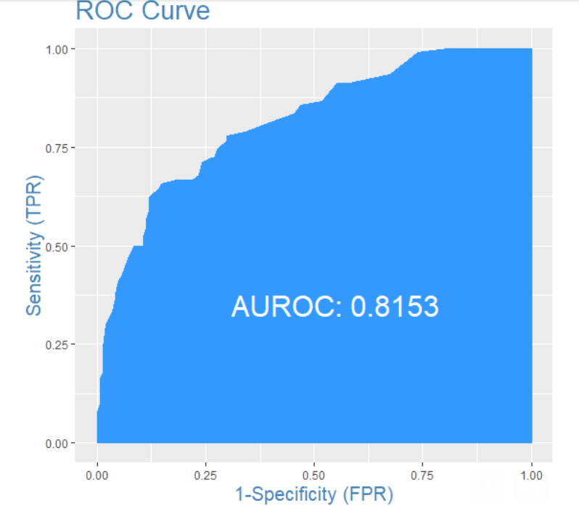
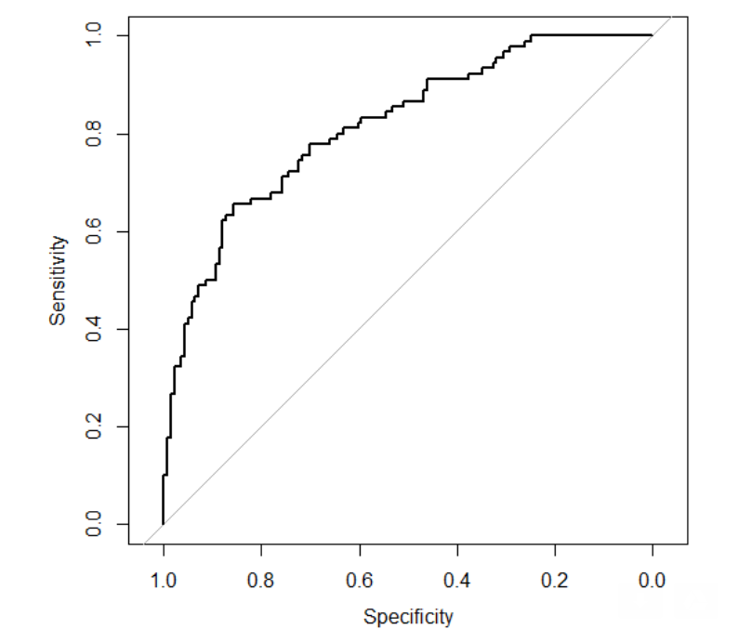
ROC and Area Under the Curve (AUC)

Slide 10
WHAT IS C5.0 ALGORITHM & WHY DO WE USE?
C5.0 algorithm is used to build either a decision tree or a rule set.
Works by splitting the sample based on the field that provides the maximum information gain.
Each subsample defined by the first split is then split again, usually based on a different field, and the process repeats until the subsamples cannot be split any further.
The lowest-level splits are reexamined, and those that do not contribute significantly to the value of the model are removed or pruned. This process is called ‘Subtree Replacement’.
Works only on categorical variable outcome.
Since our Response variable is ‘Outcome’ variable from the dataset which is a categorical variable, this algorithm can provide suitable analysis.

Slide 11
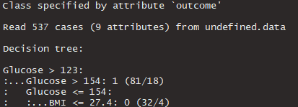
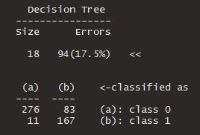
SPLITTING THE DATA & CREATING A MODEL
diabetes_train <- diabetes[index,]
diabetes_test <- diabetes[-index,]
diabetes_train$Outcome <- as.factor(diabetes_train$Outcome)
decision_model <- C5.0(diabetes_train[-9], diabetes_train$Outcome)
summary(decision_model)

Slide 12
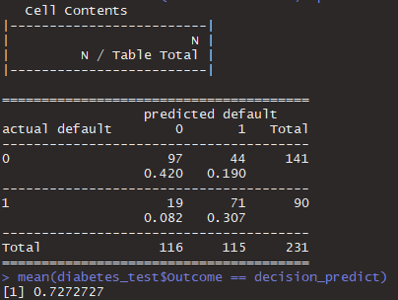
PREDICTING THE VALUES & FINDING THE ACCURACY
CrossTable(diabetes_test$Outcome, decision_predict,
prop.chisq = FALSE, prop.c = FALSE, prop.r = FALSE,
dnn = c('actual default', 'predicted default’))
mean(diabetes_test$Outcome == decision_predict)
From the Results, we can calculate the Sensitivity and Specificity.
Sensitivity = 71/90 = 0.78
Specificity = 97/141 = 0.68

Slide 13
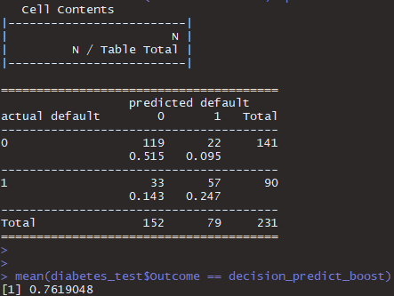
IMPROVING THE MODEL
CrossTable(diabetes_test$Outcome, decision_predict_boost, prop.chisq = FALSE, prop.c = FALSE, prop.r = FALSE,
dnn = c('actual default', 'predicted default'))
mean(diabetes_test$Outcome == decision_predict_boost)
From the Results, we can calculate the Sensitivity and Specificity.
Sensitivity = 57/90 = 0.63
Specificity = 119/141 = 0.84

Slide 14
It stores all available cases and classifies new cases based on similarity measure i.e. distance function.
It is one of the top data mining algorithm used today.
To label a new point, it looks at the labelled points closest to that new point (those are its nearest neighbors), and has those neighbors vote, so whichever label the most of the neighbors have is the label for the new point (the “k” is the number of neighbors it checks).
K-Nearest Neighbor

Slide 15
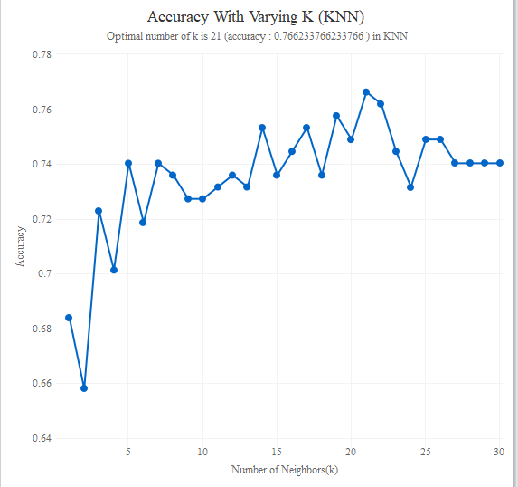
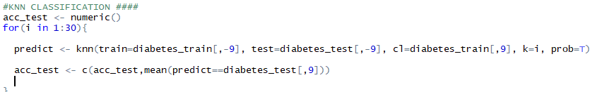
KNN Model

Slide 16
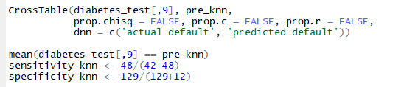
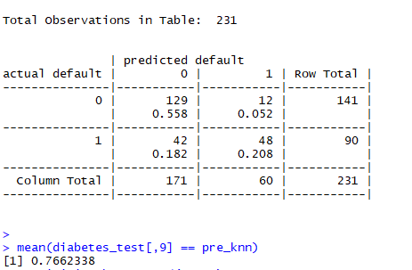

Model Results

Slide 17
CONCLUSIONS
Accuracy levels across three models:
Logistic Regression Before: 77.92% | After: 77.92%
Decision Trees Before: 72.72% | After: 76.19% KNN Classification
76.62%
In logistic regression model, the significant predictor variables are number of pregnancies, glucose, blood pressure, BMI & Diabetes Pedigree function.

Slide 18
THANK YOU

